Slide 1


IE40601 Applied Machine Learning
20161342 Keonwoo Kim
20161345 Minki Kim

Slide 2

0
CONTENTS
1. Background
4. Feature Extraction
- Efficient Market Hypothesis
- PCA (Principal Component Analysis)
2. Introduction
5. Ensembles, Prediction
- Subject, Data and method
- Sequential / Parallel Ensembles and stacking
3. Data Description
6. Conclusion
- Predictor / target variables
- Limitations and Expectation
Notes:
This is the outline of our contents.
For the first half of our presentation, let me briefly talk about why we do, how we do, and what we do.

Slide 3
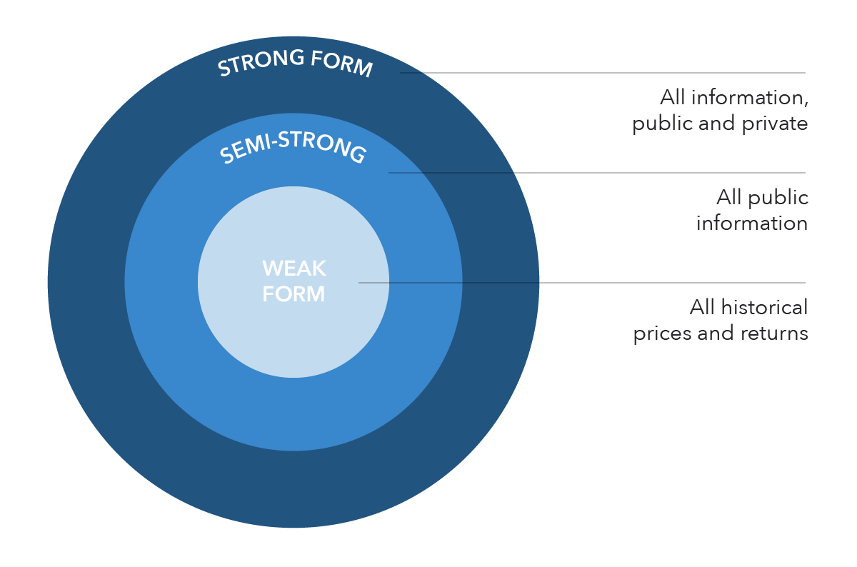
1
Background
Efficient Market Hypothesis(EMH)
: All available information are already reflected to the stock price
Three types of EMH
Weak form
Semi-strong form
Strong form
Criticism
Behavioral psychology
Market anomalies
Notes:
Before going into deep, we cannot help but consider one of the most famous hypotheses in the financial economics area, the Efficient Market Hypothesis.
The EMH states that asset prices reflect all available information. So the asset price moves like a random walk and thus it is impossible to “beat the market” consistently.
In Eugene Fama’s influential review paper, he categorized empirical tests of market efficiency into “weak-form”, “semi-strong-form”, and “strong-form” tests.
These categories of tests refer to the information set used in the statement "prices reflect all available information."
Weak-form tests study the information contained in historical prices. Semi-strong form tests study information which is publicly available. And Strong-form tests regard private information.
Generally, most of the empirical research supports the semi-strong form of EMH.
However, there also exist criticisms against EMH. Investors, including the likes of Warren Buffet, George Soros, and researchers have disputed the efficient-market hypothesis both empirically and theoretically.
Behavioral economists attribute the imperfections in financial markets to a combination of cognitive biases such as overconfidence, overreaction, representative bias, information bias, and various other predictable human errors in reasons and information processing.
Anomalies are another ground for EMH critics. There are well-known EMH anomalies such as “Small-minus-big” factor, “High-minus low” factor, Momentum factor, and so on. These factors disprove the state of EMH that all available information is reflected to the stock prices.

Slide 4
2
Introduction
Subject: Stock price prediction using Ensemble learning
Data
Ticker: 005930 (Samsung Electronics)
Range: Jan 01, 2011 ~ Dec 31, 2020
Open, High, Low, Close price + Volumes + Fundamental indicators + Other macro factors
Method
Ensemble learning
Xgboost
LightGBM
Random Forest
ExtraTreesClassifier
Stacking
Notes:
the subject of our study is predicting stock price using stacking-based ensemble learning. We use a variety of ensemble methods and stack those methods to achieve better performance.
And we aim to predict the stock price of Samsung Electronics using Open, High, Low, Close price, volume, Fundamental indicators, and other macro factors from 2011 to 2020.
With these data, we try to build an Ensemble learning model such as Xgboost, LightGBM, Random Forest, ExtraTreesClassifier, and stacked ensemble learning model.

Slide 5
3
Data Description
Predictor variables
Technical indicators - Derived variables
Price indicator
MA (Moving Average)
BB (Bollinger Band)
PSAR (Parabolic SAR)
Momentum indicator
RSI (Relative Strength Index)
MACD (Moving Average Convergence & Divergence)
Volume indicator
CO (Chaikin Oscillator)
Volatility indicator
ATR (Average True Range)
Cycle indicator
HT_DCPERIOD (Hilbert Transform – Dominant Cycle Period)
Weak-form EMH
Past stock prices, technical indicators
Semi-strong form EMH
Fundamental indicators
Strong-form EMH
Insider information
Notes:
In this slide, let me explain our predictor variables and target variable in more detail.
based on the background I explained before, we would try to predict stock prices under machine learning frameworks.
if EMH does not hold, then we can predict the future stock price using various information related to it.
More specific, if weak-form EMH does not hold, future stock prices will be affected by past stock prices and technical indicators.
A technical indicator is a mathematical calculation based on historical price, volume, open interest information that aims to forecast financial market direction.
we can make these derived variables with given open, high, low, close price, and trading volumes.

Slide 6
3
Data Description
Predictor variables
Fundamental Indicators
Net income
Operating Income Growth Ratio
PBR (Price to Book ratio)
PER (Price Earning ratio)
ROE (Return on Equity)
Debt Ratio
Asset turnover ratio
Current ratio
Gross profit growth ratio
Operating cash flows
Shares outstanding
Etc..
Weak-form EMH
Past stock prices, technical indicators
Semi-strong form EMH
Fundamental indicators
Strong-form EMH
Insider information
Notes:
Next is Fundamental indicators
If semi-strong-form EMH does not hold, future stock prices will be affected by publicly available information such as published accounting statements and information found in annual reports. These data are so-called fundamental indicators and we selected some representative financial data about the firm.

Slide 7
3
Data Description
Predictor variables
Macro factors
Global market index
DowJones, NASDAQ, S&P500
HangSeng, Sanghai, Nikkei
EuroSTOXX
FTSE
Commodity future
Crude oil, Natural gas
Gold, Silver, Copper, Aluminum
Foreign Exchange (FX)
KRWCNH (Won / Yuan)
KRWEUR (Won / Euro)
KRWUSD (Won / USD)
Semiconductor Index
Etc..
Weak-form EMH
Past stock prices, technical indicators
Semi-strong form EMH
Fundamental indicators
Other information
Macro factor
Notes:
Finally, if the strong form of EMH does not hold, security prices would be affected by private information. However, it is hard to get data about such private information. Instead, we added other factors that would affect to the stock price. Global market index, commodity future price data, Foreign Exchange rate, and so on. We used various macro factors as our predictor variables.

Slide 8
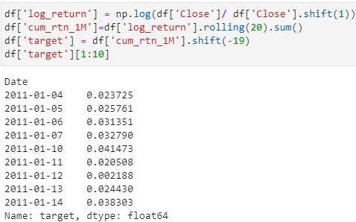
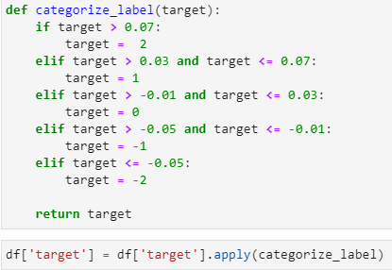
3
Data Preprocess
Target variables
Target variable: cumulative returns after 1-month -> multi-classification label
Categorize
Notes:
With the previous predictor variables, we are going to predict the 1-month later cumulative returns. Using the adjusted close prices, we created a target variable and categorized them as multi-classification labels

Slide 9
4
Methods Overview
Feature Extraction
(Principal Component Analysis)
-> Dimension Reduction
Ensembles
(XGBoost,LightGBM, RandomForest,ExtraTreesClassifier)
Stacking Ensemble
Notes:
This is the overall content of our machine learning methods. First of all, we used ‘feature extraction’ with ‘PCA’ dimension reduction method to make dimension of input data simpler. Then, we used Ensembles learning to solve out classification methods.
Both ‘parallel ensemble learning’ which reduces the bias and ‘sequential ensemble learning’ which decreases variance are utilized. After making several models, we stacked those models to improve predictions.

Slide 10


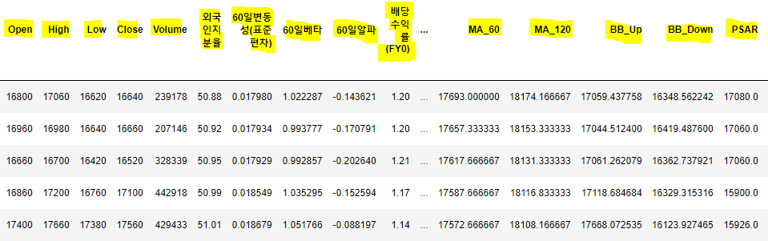
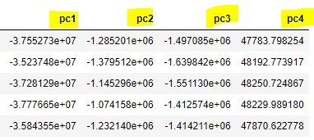
4
Feature Extraction
Reducing dimensions from 33 to 4 by using PCA (Principal Component Analysis) dimension reduction method. Not just selecting features on original data, by having linear combinations among features, we just chose 4 features.
Notes:
The shape of original data has 33 features. We used feature extraction method by using ‘PCA’ dimension reduction method, then, the posterior number of features comes to be 4.

Slide 11
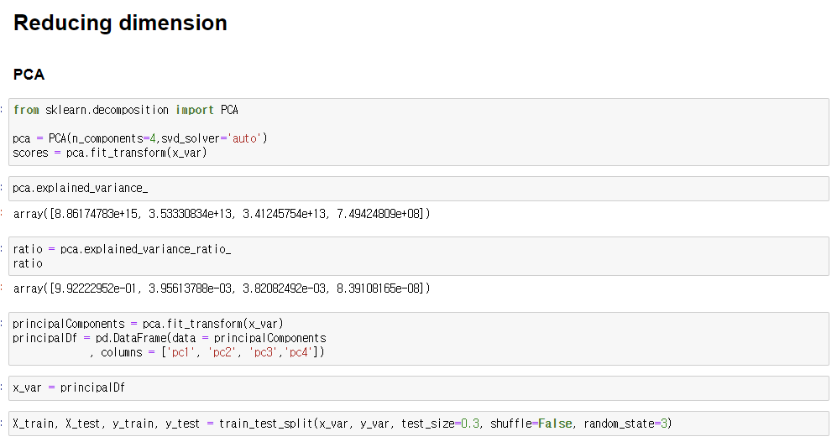
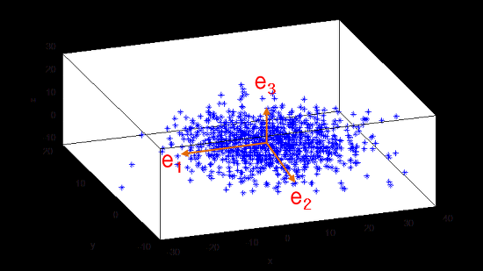
4
Feature Extraction
- If we project the data to lower dimension, which vector should we project the data to best maintain the original data structure?
- When data is projected to one axis, the axis with the largest variance is ‘PC1’, and the second largest variance is ‘PC2’ etc.
Notes:
To maintain the original data information as much as possible, we should select axis with having large variance. So we extracted ‘PC1, PC2, PC3, and PC4’ features.

Slide 12
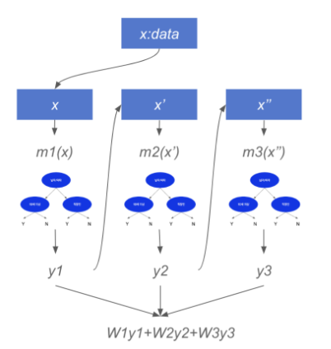
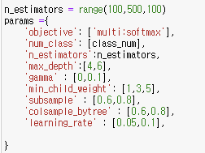
5
Ensembles (Sequential Ensemble Learning - Boosting)
XGBoost (Extreme Gradient Boosting)
One of the strongest ensemble models based on Boosting method.
Ensemble technique implemented to make GBM parallel learning.
Unlike GBM, XGBoost has its own overfitting regularization method.
CART (Classification and Regression tree) ensemble model
Hyperparameters sets used in Grid Search
Notes:
Input data after PCA is used on several ensemble classification models. The first one is ‘XGBoost’ (‘Extreme Gradient Boosting) method. ‘XGBoost’ is one of the strongest ensemble models which can be utilized both on ‘classification and regression tree problems’ based on boosting methods. The representative feature is its learning algorithm makes ‘gradient boosting method’ as parallel learning. Also, unlike GBM, it has its own overfitting regularization method itself. Even though there are a lot of hyperparameters on XGBoost, we only chose 9 hyperparameters on our problem.
Let me briefly talk about them. Since we solve multi class classification problems, we select ‘muli:sofmax’ as objective and 5 number of classes. And we set the number of estimator which is ‘weak learner’ from 100 to 500 on 100 size step. Also, we set the maximum depth of each tree as 4 or 6, if its value is very large there will be overfitting problem. Then, we set the gamma which decides additional split on leaf node as 0 or 1, when its value is large enough it controls overfitting problem. Min_child_weight works similar to GBM’s min_samples_leaf which refers to minimum summation value of observed data’s weight and we set it as 1 or 3 or 5. Sub_sample controls data sampling ratio which controls overfitting as 0.6 or 0.8.
Colsample_bytree works in feature sampling when making tree and set it as 0.6 or 0.8.

Slide 13
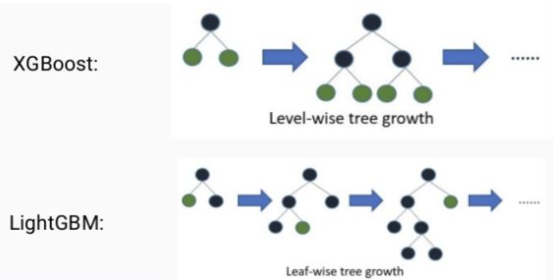
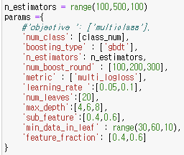
5
Ensembles (Sequential Ensemble Learning - Boosting)
LightGBM (Light Gradient Boosting Method)
Less time consumed and lower number of hyperparameter compared to XGBoost.
Unlike XGBoost, LightGBM can process large amounts of data and is faster using less memory than other models.
Unlike conventional boosting models that use a ‘level-wise’ stretching method of trees, LightGBM splits trees based on ‘leaf-wise’ method.
‘level-wise’ : A structure that is strong against overfitting by maintaining the most balanced tree and minimizing the depth of the tree, but requires a lot of time to balance
‘leaf-wise’ : A structure where trees are deepened and asymmetrically generated while continuously splitting leaf nodes with maximum loss values. Minimize the loss of predictive error.
Hyperparameters sets used in Grid Search
Notes:
Second ensemble model is LightGBM (Light Gradient Boosting Method) which is also one of boosting methods. It takes less time consumed and lower number of hyperparameter compared to XGBoost. Unlike XGBoost, it can process large amounts of data and is faster using less memory than other models. Also, unlike conventional boosting models which use ‘level-wise’ stretching method of trees, LightGBM’ splits tree based on ‘leaf-wise’ method.
It is one of the representative features on LGBM. and hyperparameters were framed similar to XGBoost above which I talked about before this page.

Slide 14
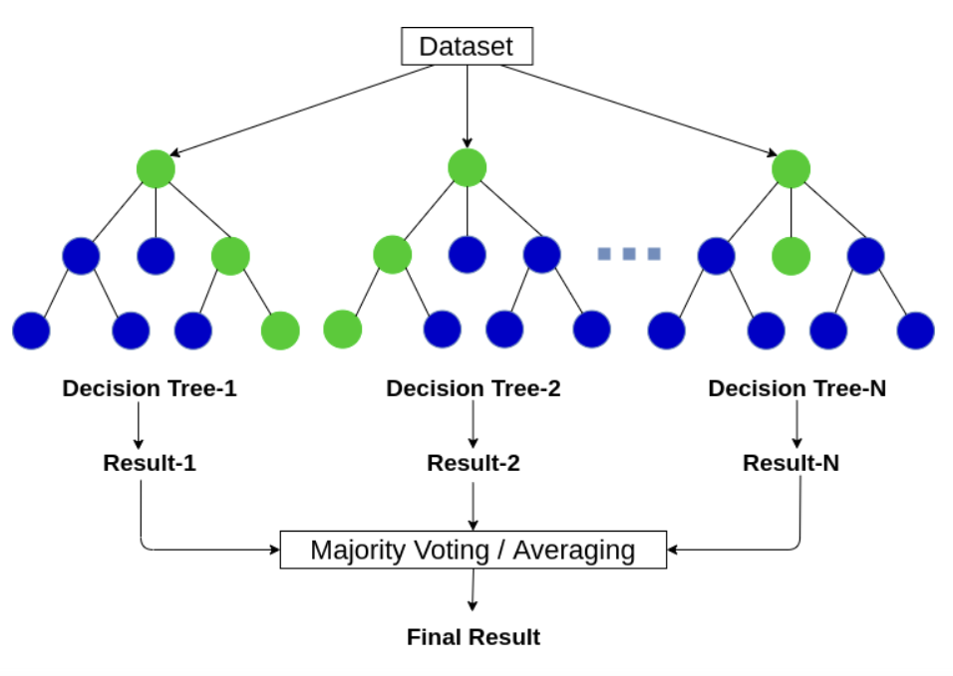
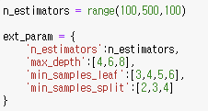
5
Ensembles (Parallel Ensemble Learning) - Bagging
Random Forest
Forming multiple decision trees, the result of vote in each tree classifier will be selected to final result.
By creating a large number of trees, it can prevent overfitting from having a significant impact on prediction.
Extra Trees Classifier
A variant of the Random Forest
Extra trees increase randomness by randomly splitting each candidate characteristic of the forest tree.
Both Random Forest and Extra Trees share same Hyperparameters.
They both utilize bagging method which forms a tree by using a subset of the training set.
Hyperparameters sets used in Grid Search
Notes:
The last two ensembles which are parallel ensemble learning by bagging method are ‘random forest’ and ‘extra trees classifiers’. Random forest forms multiple decision trees and the result of vote in each tree classifier will be selected to final result. By creating a large number of trees, it can prevent overfitting from having a significant impact on prediction.
The next one is ‘extra trees classifier’ which is a variant of random forest. It increases randomness by randomly splitting each candidate characteristic of the forest tree. Both random forest and extra trees classifier share same hyperparameters which are ‘n_estimators’, ‘max_depth’, ‘min_sample_leaf’ and ‘min_samples_split’.

Slide 15
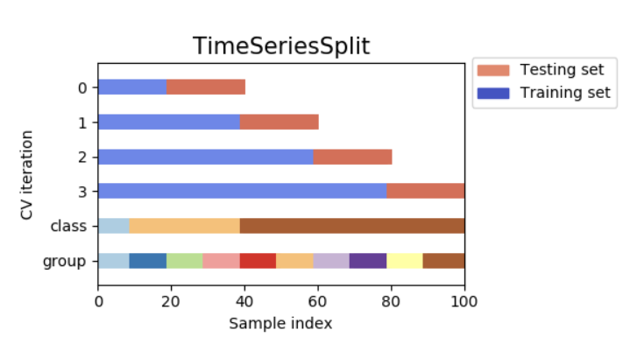
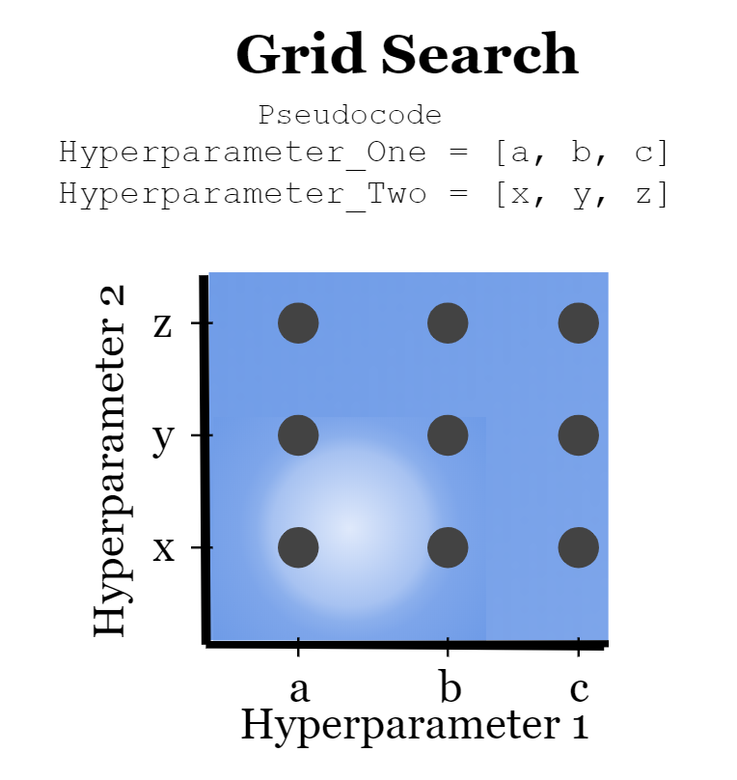
5
Hyperparameter Tuning
Time series Cross Validation (n_splits = 5)
Stock data is time series data so it should maintain consecutive data.
It uses the data trained earlier continuously next process.
Proceeding by growing the scale of the train data.
Grid Search (Hyperparameter Tuning Method)
Use Time series split as cross validation .
Find out optimal hyperparameter from user-designated sets on each ensemble models
by checking the performance by putting hyperparameter from the set one by one.
Notes:
I used ‘Grid Search’ method to find out best hyperparameters on each ensemble models. It works by checking the performance by putting hyperparameter form the set one by one. Also, the important thing on here is that we should consider the characteristic of stock data which has ‘time series consecutive data’. Thus, we use Grid Search with using time series cross validation which uses the trained earlier continuously next process.

Slide 16
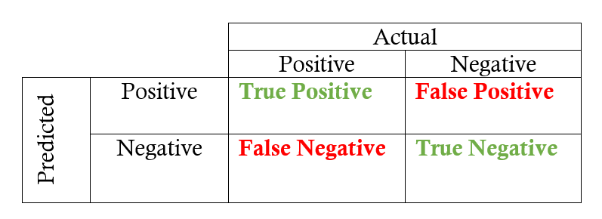
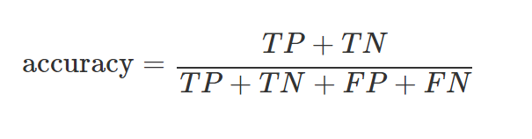


5
Evaluation Metrics (Accuracy)
- Since the data itself is not imbalanced, considering other metrics such as ‘Precision, Recall, F1 Score’ is not important but only ‘Accuracy’.
- Balanced ratio among labels (-2, -1, 0, 1, 2) on both train and test data.
Notes:
When finding out best performance, we only set evaluation metrics as ‘accuracy’. Since the label ratios on train set and test set is balanced, only concentrating on accuracy rather than using other metrics such as ‘precision, recall, f1 score’, would work simpler.

Slide 17
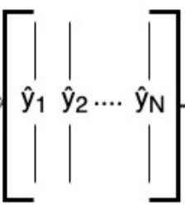

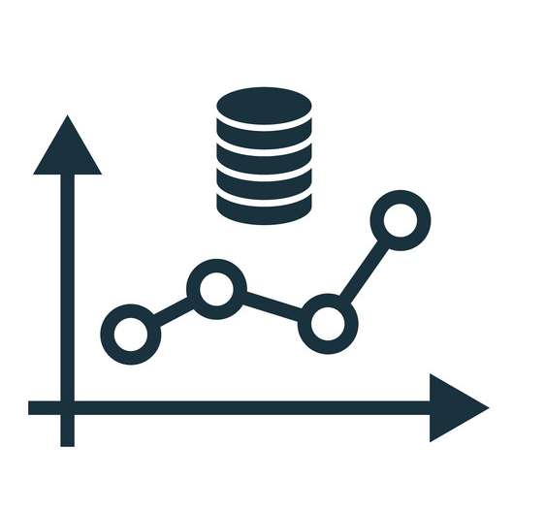
5
Base-learners
Ensembles (Stacking)
XGBoost
Predictions
Meta-Learner
Final-Predictions
LightGBM
Input
Train Set
RandomForest
ExtraTreesClassifier
Notes:
Stacking learning is a method which utilizes prediction data from each classifier model as training set. Thus, the prediction results on XGBoost, LightGBM, RandomForest and ExtraTreesClassifier will be utilized as training set on meta-learner. We set meta-learner with XGBoost, then find out final-prediction outcomes.

Slide 18
6
Ensembles (Stacking) without PCA
Ensemble Classifier | Accuracy (Test set) | Ensemble Classifier | Accuracy (Test set)
XGBosot | 19.51% | LightGBM + ExtraTreesClassifier | 23.10%
LightGBM | 20.52% | RandomForest + ExtraTreesClassifier | 23.10%
RandomForest | 23.39% | XGBoost + LightGBM + RandomForest | 24.25% (BEST)
ExtraTreesClassifier | 20.09% | XGBoost + LightGBM + ExtraTreesClassifier | 21.38%
XGBoost + LightGBM | 21.23% | XGBoost + RandomForest + ExtraTreesClassifier | 20.52%
XGBoost + RandomForest | 21.52% | LightGBM + RandomForest + ExtraTreesClassifier | 23.10%
XGBoost + ExtraTreesClassifier | 17.22% | XGBoost + LightGBM + RandomForest + ExtraTreesClassifier | 24.10%
LightGBM + RandomForest | 24.25% (BEST)
Notes:
This is the result of ensembles’ learning accuracy on test set without feature extraction (PCA). The one with LightGBM+RandomForest and XGBoost+LightGBM+ExtraTreesClassifier show the best accuracy higher than stacking all ensemble models over 0.1%.

Slide 19
6
Ensembles (Stacking) with PCA
Ensemble Classifier | Accuracy (Test set) | Ensemble Classifier | Accuracy (Test set)
XGBosot | 17.93% | LightGBM + ExtraTreesClassifier | 22.67%
LightGBM | 19.26% | RandomForest + ExtraTreesClassifier | 19.80%
RandomForest | 15.49% | XGBoost + LightGBM + RandomForest | 23.82% (BEST)
ExtraTreesClassifier | 18.22% | XGBoost + LightGBM + ExtraTreesClassifier | 21.66%
XGBoost + LightGBM | 23.67% | XGBoost + RandomForest + ExtraTreesClassifier | 19.08%
XGBoost + RandomForest | 20.66% | LightGBM + RandomForest + ExtraTreesClassifier | 21.52%
XGBoost + ExtraTreesClassifier | 20.23% | XGBoost + LightGBM + RandomForest + ExtraTreesClassifier | 23.53%
LightGBM + RandomForest | 23.39%
Notes:
This is the result of ensembles’ learning accuracy on test set with feature extraction (PCA). The one with XGBoost+LightGBM+ExtraTreesClassifier show the best accuracy higher than stacking all ensemble models over 0.3%.

Slide 20
4
Ensembles (stacking)
LightGBM + RandomForest (24.25%)
(Stacking without PCA)
XGBoost + LightGBM + RandomForest (23.82%)
(Stacking with PCA)
XGBoost + LightGBM + RandomForest (24.25%)
(Stacking without PCA)
Better performance
Notes:
Also, unlike our intention, the input data without feature extraction works better than other over 0.4%.

Slide 21
6
Conclusion
Market Efficiency
Hard to predict returns
Notes:
So far, we assumed that the market is not efficient. So under that assumption, we applied technical indicators, fundamental indicators, and other macro factors. However, although we increase the predictive accuracy using various ensemble models and stacking methods, the result seems not so good. Thus, we conclude that even though the market could be temporarily inefficient due to some anomalies and behavioral psychology, eventually the market is efficient on average so it is hard to predict future returns of any securities.

Slide 22
THANK YOU

